Slide 1
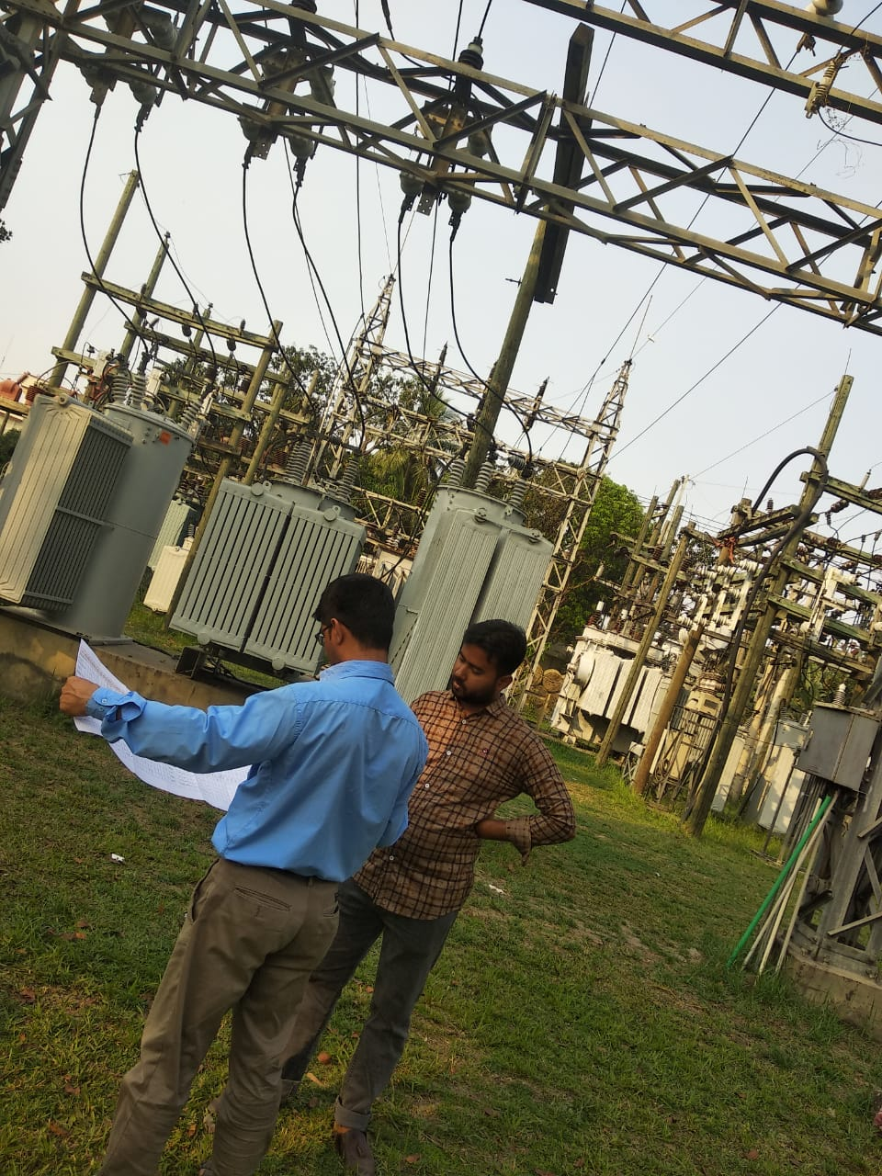



UTILITY GIS • FIELD TO PLATFORM
Utility Network
Intelligence
Electrical • Water • Gas
A connected operating model for field survey, asset digitization, consumer indexing, topology validation and enterprise GIS migration.
Customer capability presentation
JSAN Consulting
Notes:
Opening message: JSAN can support the full utility digitization lifecycle from field capture to enterprise GIS readiness across electrical, water and gas networks.

Slide 2

EXECUTIVE MESSAGE
One operating model can digitize three utility domains while preserving domain-specific asset and safety requirements
The source material consistently points to the same backbone: field evidence → QA/QC → GIS database → operational map products.
Electrical
Water
Gas
Pole-to-pole network capture, land-base extraction, consumer survey and topology-ready electrical network mapping.
Distribution-asset and consumer indexing designed to improve network visibility, maintenance planning and leak response.
Safety-focused asset inventory and service-area mapping with traceable field evidence and operational GIS outputs.
Pole / line / transformer digitization
Pole codification and field verification
Migration to GE Smallworld / ArcGIS
Valves, hydrants and meters
Consumer connection mapping
Zonal / DMA-wise map outputs
Pipelines, valves, regulators
Pressure stations and service connections
Pressure zone / service-area maps
Executive implication
Standardize the shared data, QA and delivery backbone once—then configure asset taxonomy, topology rules and operational outputs by utility.
Source: JSAN utility use-case presentation supplied by user. Metrics should be validated against the customer baseline before external commitment.
Notes:
Use this slide to frame the discussion around a common operating model, not three disconnected survey projects.

Slide 3
DELIVERY CAPACITY
JSAN combines GIS operations, field capacity and recruitment depth to support multi-region utility programs
Capabilities and staffing figures below are reproduced from the supplied source deck.
200+
20+
1,000+
70+
CAD / GIS engineers
GIS managers
Field experts
Recruiters
Offshore / onshore GIS production
Operational and quality leadership
Field collection capacity
Dedicated recruitment engine
Capability stack
Mobilization engine
Utility GIS
Asset mapping
Telecom, electrical & water networks
Asset mapping & topology validation
Dedicated recruitment team
70+ recruiters with stated experience hiring GIS resources across geographies.
LiDAR & photogrammetry
Enterprise GIS
Processing for field-to-map workflows
Spatial databases and system upgrades
Applications
Testing & support
Stated onboarding capability
Development, implementation & training
Testing, maintenance and ongoing support
100+ resources within weeks
Source: JSAN utility use-case presentation supplied by user. Metrics should be validated against the customer baseline before external commitment.

Slide 4
PROGRAM READINESS
Data readiness is the first control point: network drawings, asset inventory, consumer records and GIS rules must be aligned before field mobilization
The source deck defines a concrete input checklist and common consumer information required across all three utility domains.
Client inputs required
Common consumer information
Network drawings
Existing CAD / PDF network drawings
Required for electrical, water and gas utility workflows
Asset inventory
Existing asset data and identifiers
Consumer ID
Meter number
Consumer database
Consumer and service-connection records
Consumer name
Tariff category
Address
Billing data
Base maps
Base maps and satellite imagery
Account number
Service connection details
GIS standards
Data model, coding, connectivity and topology rules
Field access
Survey requirements, field permissions and target GIS platform
Utility department standards
GIS schema • attributes • coding • naming • connectivity • topology
Source: JSAN utility use-case presentation supplied by user. Metrics should be validated against the customer baseline before external commitment.

Slide 5
OPERATING MODEL
A six-stage field-to-platform operating model converts physical assets into governed GIS records and decision-ready network maps
The same backbone applies across utilities; domain-specific rules are configured within capture, validation and data-model steps.
1
Prepare
2
Capture
3
Validate
4
Model
5
Integrate
6
Operate
Base maps, satellite imagery, source drawings and survey plans
GPS / mobile / drone-enabled asset and consumer evidence
Spatial, attribute, photo and field-completeness checks
Network connectivity, asset hierarchy and topology rules
Prepare GDB and migrate to target GIS platform
Maps, dashboards, maintenance and decision support
Design principle
Every asset record should be traceable back to field evidence, a defined data model and an explicit QA decision.
Source: JSAN utility use-case presentation supplied by user. Metrics should be validated against the customer baseline before external commitment.

Slide 6
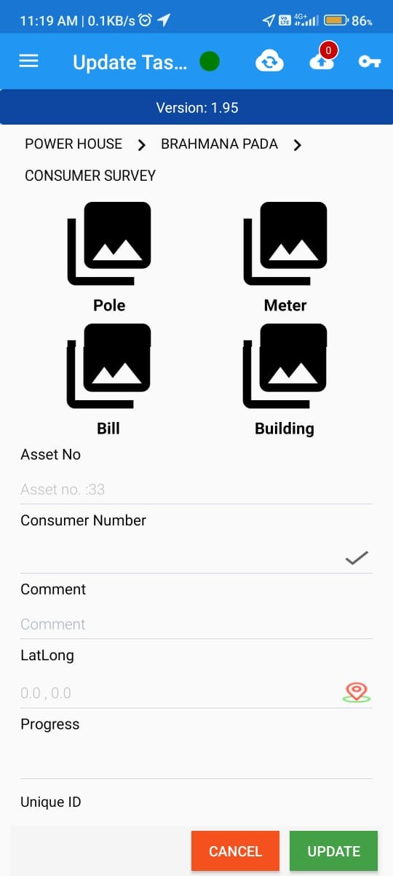
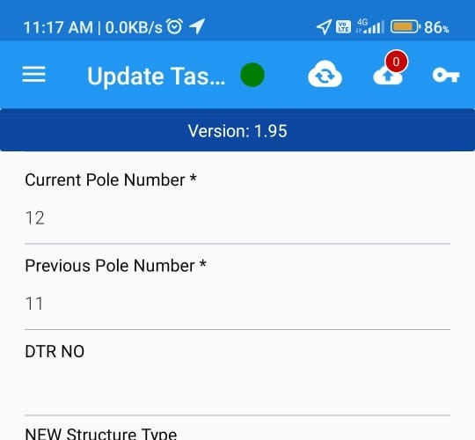
ELECTRICAL UTILITY
Electrical digitization links land-base extraction, pole-to-pole survey and topology QA before enterprise GIS migration
The source workflow moves from base-map preparation through field survey, GDB creation and final customer approval.
1
2
3
4
5
6
7
8
9
10
Land base
Field survey
Asset drawing
Codification
QA/QC
GDB
Field verify
Correct
Approve
Migrate
Satellite image extraction
Drone / mobile app
Pole-to-pole network
Pole number standards
Spatial + attribute
Model preparation
Base-map validation
Post-field updates
Final network map
Smallworld / ArcGIS
Field evidence
Control objectives
Spatial accuracy
Attribute quality
Pole / line location and base-map fit
Asset type, identifier and consumer linkage
Topology integrity
Migration readiness
Connectivity and network rules
GDB structure aligned to target platform
On-ground survey + structured mobile capture
Source: JSAN utility use-case presentation supplied by user. Metrics should be validated against the customer baseline before external commitment.

Slide 7
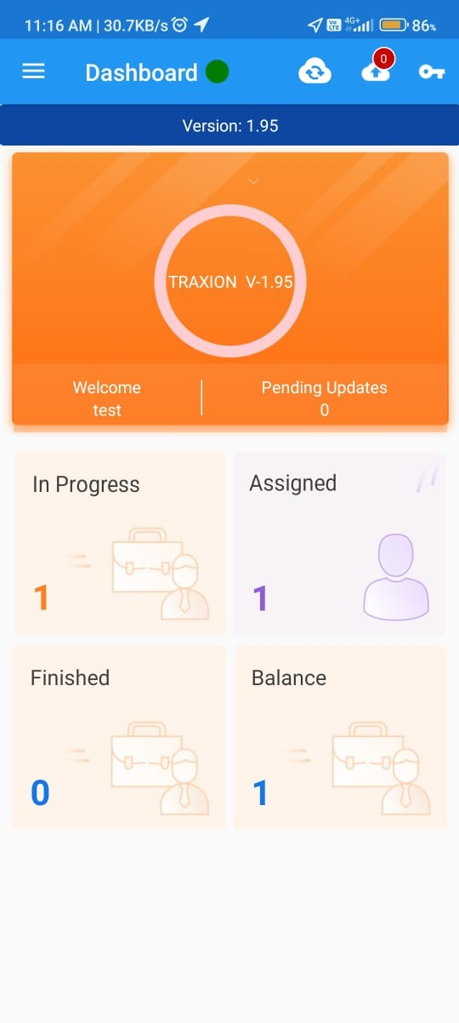
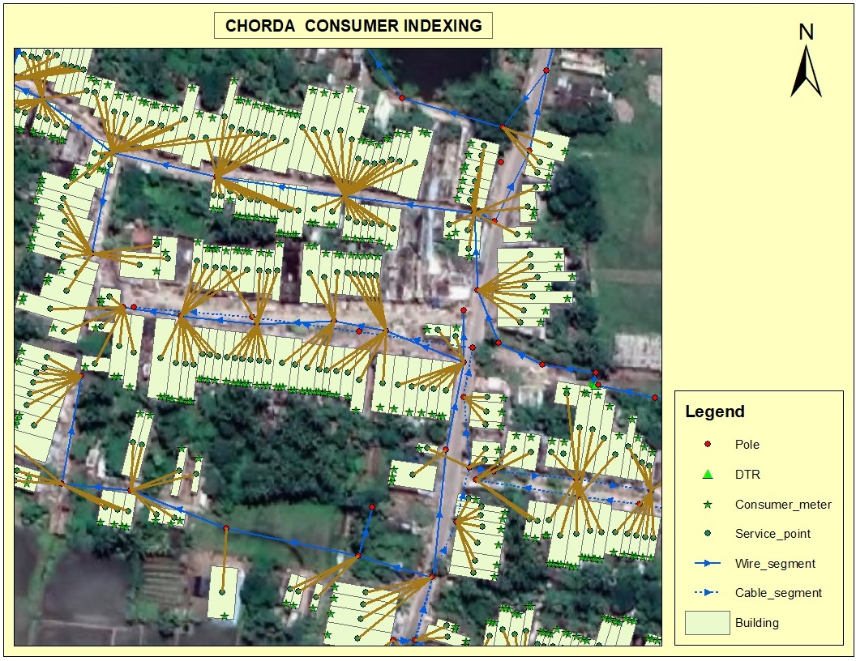
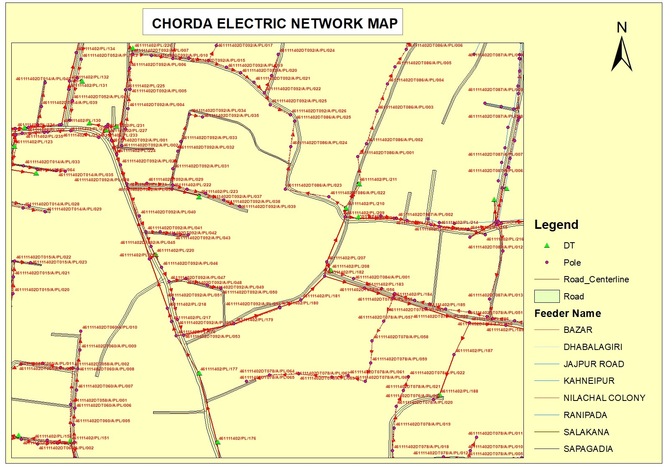
ELECTRICAL UTILITY
Electrical delivery becomes auditable when field evidence, consumer indexing and final network maps are presented together
Mobile-app records and map products in the source deck provide the evidence chain from capture to final GIS deliverable.
Evidence chain
Electrical delivery outputs
Land-base / reference layers
Electrical asset network map
Consumer indexing map
GIS geodatabase
QA/QC status and corrections
Target-system migration package
Capture
Structure
Index
Deliver
Field app
Asset attributes
Consumer map
Network map
Approve migration-ready network data with visible field lineage.
Customer decision enabled
Result: a traceable GIS record linking asset coordinates, attributes, consumer context and approved network geometry.
Source: JSAN utility use-case presentation supplied by user. Metrics should be validated against the customer baseline before external commitment.

Slide 8
WATER UTILITY
Water digitization connects distribution assets and consumer indexing to maintenance, leak-response and zone-level planning
The supplied use case emphasizes GIS coordinates, GPS-enabled asset registers and water-distribution / DMA map outputs.
Field-to-GIS workflow
Business outcomes in source deck
30–40%
reduction in asset search time
Survey
GPS capture
GIS database
Dashboard
Source-deck claim; baseline validation required
10,000+
Representative assets
Key outputs
assets / day collection capability
Valves
Hydrants
Water distribution network GIS
Consumer indexing database
GPS-enabled asset register
Zonal / DMA-wise utility maps
Source-deck capability statement
Meters
Consumer connections
95%+
location accuracy
Source-deck claim
Additional stated benefits: improved leak identification, better maintenance planning and regulatory-compliance support.
Source: JSAN utility use-case presentation supplied by user. Metrics should be validated against the customer baseline before external commitment.

Slide 9
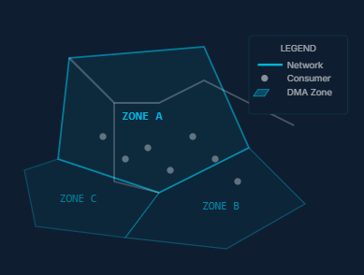
WATER UTILITY
Water operations gain value when mobile capture, network maps and zonal intelligence are delivered as one operational dataset
Offline collection, photo capture, GPS validation and synchronization are part of the source use case.
Mobile field collection
Distribution and consumer map outputs
Operational intelligence
Asset visibility
Locate and validate field assets
Typical delivery maps
Maintenance planning
Prioritize inspections and work
Consumer connection mapping
Asset photo capture + geo-tagging
Offline data collection
GPS validation and synchronization
Water distribution network
Consumer indexing
Zonal / DMA-wise utility views
Leak response
Improve spatial context for incidents
Zone control
Support DMA / zonal decisions
Source: JSAN utility use-case presentation supplied by user. Metrics should be validated against the customer baseline before external commitment.

Slide 10
GAS UTILITY
Gas digitization prioritizes safety-critical asset traceability, service connections and pressure-area intelligence
The source use case combines GPS survey, photo documentation, optional barcode / QR capture and GIS map generation.
Assets captured
Process flow
Stated business value
Pipelines
1
Field survey
Improved safety compliance
Faster leak response
Reduced asset loss
Accurate network inventory
GPS-enabled asset and consumer capture
Valves
2
Asset capture
Regulators
Attributes, photos and identifiers
Service connections
3
QA/QC
Source-deck KPI claims
Spatial and attribute validation
Meters
95%+
survey accuracy
4
GIS database
Structured network and consumer records
40%
Pressure stations
reduction in field revisit
5
Operations dashboard
Maps and service-area intelligence
Source: JSAN utility use-case presentation supplied by user. Metrics should be validated against the customer baseline before external commitment.

Slide 11
GAS UTILITY
Gas delivery is strongest when field-survey proof, network imagery and pressure-zone outputs can be reviewed side by side
This creates a practical evidence package for safety, network expansion and emergency-response planning.
Network / service-area map evidence
Operational uses
Leak management
Network expansion
Pressure monitoring
Gas distribution network maps
Consumer indexing maps
Pressure-zone / service-area maps
Emergency response
GPS-enabled field survey + photo documentation
Asset visibility → Network intelligence
Source: JSAN utility use-case presentation supplied by user. Metrics should be validated against the customer baseline before external commitment.

Slide 12
DATA MODEL
A common geospatial data model creates consistent asset, consumer and topology records while preserving utility-specific attributes
The program can standardize cross-utility governance without flattening electrical, water or gas domain logic.
Electrical-specific
Common utility GIS core
Pole and conductor attributes
Transformer and electrical assets
Pole codification
Electrical topology / connectivity
Asset ID + class
Gas-specific
Coordinates + geometry
Consumer / service link
Pipeline / valve / regulator attributes
Meter and service-connection linkage
Pressure station records
Pressure-zone / service-area context
Photo / field evidence
Water-specific
Status + QA disposition
Valve / hydrant / meter attributes
Water distribution hierarchy
Zonal / DMA associations
Leak and maintenance context
Connectivity / topology rules
Source: JSAN utility use-case presentation supplied by user. Metrics should be validated against the customer baseline before external commitment.

Slide 13
QUALITY & GOVERNANCE
Quality is engineered through gate-based controls—from field completeness to topology integrity and migration readiness
The source material repeatedly places QA/QC before customer approval and final GIS migration; this slide consolidates those controls into a single governance model.
G1
G2
G3
G4
G5
G6
Field completeness
Spatial QA
Attribute QA
Topology QA
Customer approval
Migration readiness
Asset present, coordinate captured, mandatory attributes and evidence
Base-map fit, GPS precision, geometry and positional plausibility
Codes, names, IDs, consumer linkage and utility-specific fields
Connectivity, network rules, gaps, overlaps and logical relationships
Review corrections, exceptions and delivery acceptance
GDB / target-system schema, packaging and traceability
Field team
GIS production
QA / GIS manager
Customer
Program management
Capture + first-time completeness
Digitization + model compliance
Independent quality gates + exceptions
Standards, approvals + acceptance
Governance, reporting + escalations
Source: JSAN utility use-case presentation supplied by user. Metrics should be validated against the customer baseline before external commitment.

Slide 14
IMPLEMENTATION
A mobilize-to-scale roadmap can validate standards early, prove field-to-GIS quality in a pilot and then expand by geography or utility
Sequence is illustrative because the source deck does not specify project durations; timing should be baselined with the customer.
01
02
03
04
05
Mobilize
Design
Pilot
Production
Migrate & operate
Scope, stakeholders, standards, data access, field permissions
Data model, taxonomy, topology rules, mobile forms, QA gates
Controlled area, representative assets, evidence capture, customer review
Scaled field collection, GIS production, QA/QC and reporting
GDB packaging, target GIS migration, dashboards and handover
Exit output
Exit output
Exit output
Exit output
Exit output
Approved plan + readiness checklist
Configured solution + acceptance criteria
Validated workflow + quality baseline
Approved network + consumer datasets
Operational GIS + support model
Scale logic: validate once → standardize repeatable controls → expand by service area / geography → tune only the utility-specific data model and field rules.
Source: JSAN utility use-case presentation supplied by user. Roadmap sequencing is an illustrative synthesis; durations are not stated in the source.

Slide 15
From field reality to
operational utility intelligence
Electrical • Water • Gas
A repeatable GIS delivery backbone for asset visibility, network intelligence, operational efficiency and digital transformation.
www.jsanconsulting.com
Thank you
Notes:
Close on the operating model: survey, evidence, QA, structured GIS and operational outputs. Invite discussion on customer geography, utility, standards and target GIS platform.

